Slide 1
E Learning Session - Intracranial injuries… Dr. Nirmala Perera & Dr. P.Paranitharan
Computer Designing by Dr. Udara Senarathne

Slide 2

Objectives…
You should utilize this ELS to achieve the following;
Fire arm
Identify the injuries caused by different types of fire arm.
Identification of entry and exit wound
Identify circumstances of firearm injury

Slide 3
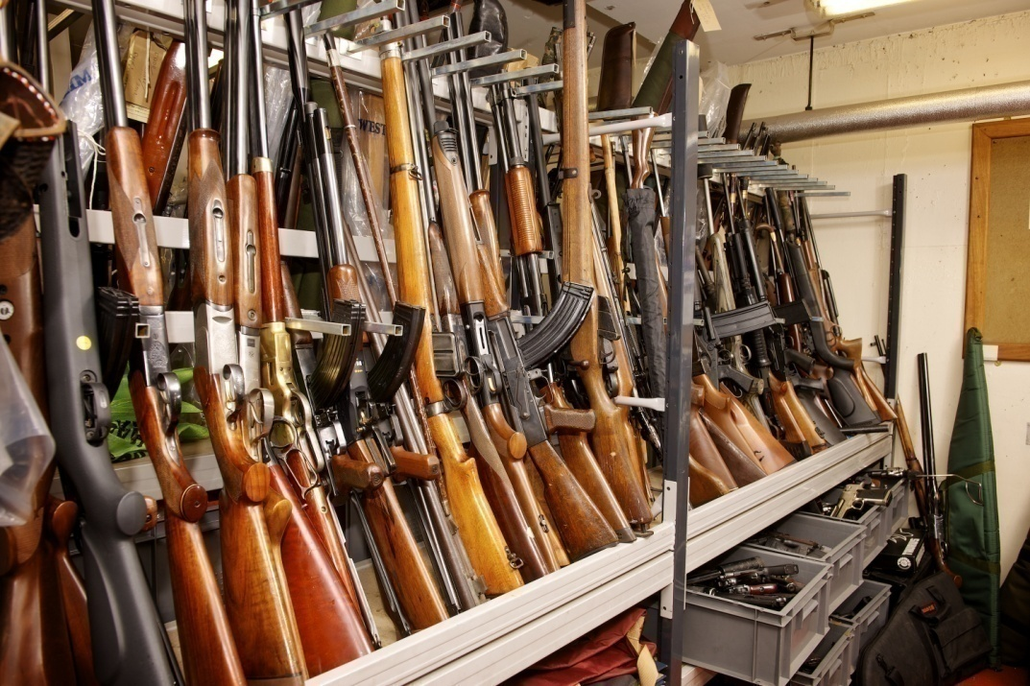
Firearm Injuries…
A firearm is any instrument which discharges a missile by the expansive force of the gases produced by burning of an explosive substance.
Forensic Ballistics is the science dealing with the investigation of firearms, ammunition and the problems arising from their use.

Slide 4
Objectives…
You should utilize this FLS to achieve the following;
Fire arm
Identify the injuries caused by different types of fire arm
Identification of entry and exit wound
Identify circumstances of firearm injury

Slide 5

Fact file…
There are 2 types of firearms…

Slide 6
2 types of firearms…
Rifle
Smooth bore
Inside barrel has groves
Bullets
Can fire long distance
Inside barrel is smooth
Pellets
Can fire short distance

Slide 7
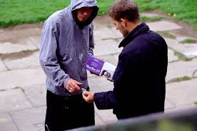
Case Scenario…
A 50yr old male who was later revealed to be a leader of a local drug dealing gang was found dead at a junction of a road. There were multiple firearm injuries on the body of the victim. The victim was found to be shot from intermediate range.

Slide 8
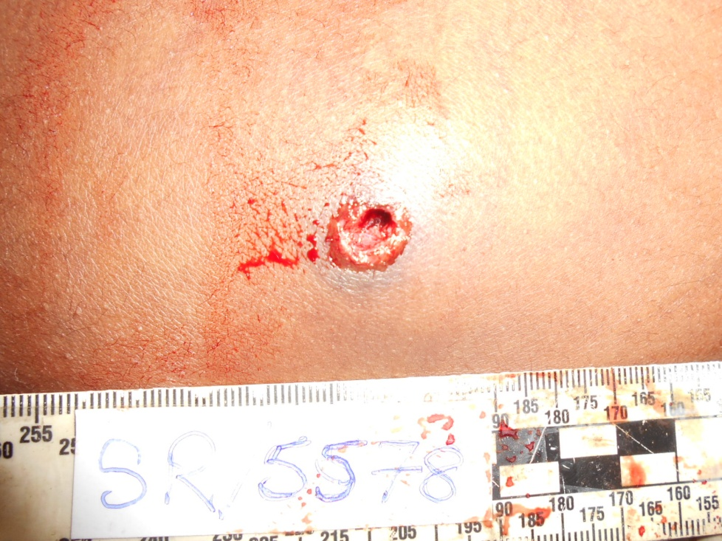
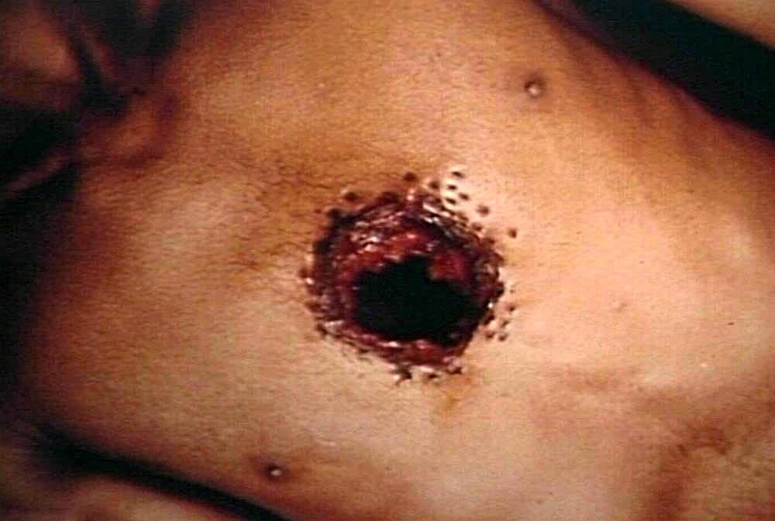
1. How would you identify the type of firearm by examining the injuries ?
A
B

Slide 9
1. How would you identify the type of firearm by examining the injuries?
 | Rifle (A) | Smooth bore (B)
Edge of the wound | Circular hole with inverted margins | Scalloped edges (rat hole)
Satellite wounds | Absent | Present
Wad mark | Absent | Present as a laceration/contusion below the main wound but not visible in this case
Abrasion collar | Present | Absent
Grease ring | Present | Absent

Slide 10
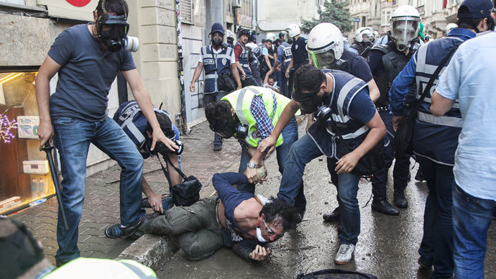
Case Scenario…
A 20yr old male was shot during a police raid. He was admitted to a surgical unit and the MO medico legal was summoned to do medico-legal examination of the patient. Eye witness reported that the man was shot by a rifle.

Slide 11
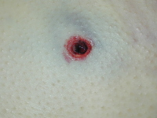
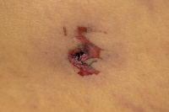
1. What are the features that would help the MO medico-legal to differentiate an entry wound from an exit wound?
A
B

Slide 12
1. What are the features that would help the MO medico-legal to differentiate an entry wound from an exit wound?
 | Entry wound (A) | Exit wound (B)
Shape | Circular hole with inverted margins | Stellate and everted
Abrasion collar | Present | Absent
Burning Blackening Tattooing | May be present depending on the range of fire but not present in this case | absent

Slide 13
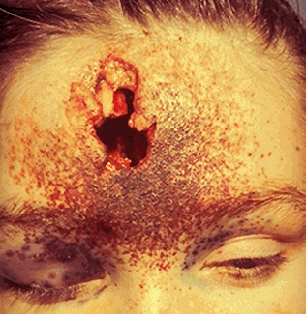
Case Scenario…
A 35yr old male was found dead inside a room with a circular laceration on the forehead.

Slide 14
1. Which of the following features will indicate this case as a firearm suicide?
Room is locked from inside.
Weapon is absent from the scene.
Presence of more than one fatal injury.
Elective site.
Entry wound is compatible with the handedness.
Injuries present in inaccessible area.

Slide 15
1. Which of the following features will indicate this case as a firearm suicide?
Room is locked from inside. (T)
Weapon is absent from the scene. (F)
Presence of more than one fatal injury. (F)
Elective site. (T)
Entry wound is compatible with the handedness. (T)
Injuries present in inaccessible area. (F)

Slide 16

Now can you?
Identify the injuries caused by different types of fire arm.

Slide 17
YES! You Can!

Slide 18

GOOD JOB!

Slide 19

Good Luck !

